Slide 1
House Price prediction
MTH 209 - Data Science Lab 2
Instructor : Dr. Subhajit Dutta
Group: Statistica

Slide 2

Meet our Team members
Hemant Sanjay Nikhade (M.Sc) (C)
Mayuresh Mandar Joshi (M.Sc)
Vishnu Vardhan Vadhtya (M.Sc)
Shivam Chaurasia (M.Sc)
Kunal Dayma (B.S)

Slide 3

Problem Statement
Customer
confused while buying house

Slide 4

Our Team
As customers encounter difficulties, we've conceived the innovative idea of creating a project to address their concerns.

Slide 5
Outline:
Introduction
Problem Statement
Project Specification
Dataset
Data Cleaning
Outlier Detection
Outlier Removal
One Hot Encoding
Model Creation
K- Fold cross validation
Grid search cross validation
Result/ output

Slide 6
Introduction:
In this project, we have built Machine learning model to predict the house prices of an Indian city [Bengaluru].
This project will very helpful for the real estate market.
Our model can be used by both house sellers and buyers.
Multiple Linear Regression algorithm is used to create a model with a great accuracy score.

Slide 7
Problem statement:
Buying houses is everyones basic need and while buying house everyone get confused.
Why in some area prices are more?
Why 1 bhk is more expensive than 2 bhk in some area?
How number of bathrooms and bhk are important factors for price of house?
Is this house price correct?
Proper and justified prices of properties W bring in a lot of transparency and trust back to the real estate industry , which is very important for most consumers especially in India.

Slide 8
Dataset:
Dataset comes from kagle.com.
Link of the dataset – “ Bengaluru House price data (kaggle.com)”
There are 13320 number of observation in our dataset.
There are a total 9 columns / attributes in our dataset.
The all 9 columns are area_type, availability, location, size, total_sqft, bath, society, balcony and price.
We have used a total of 5 features to train our machine learning model.

Slide 9
Pipeline:
DATA CLEANING
FEATURE ENGINERING
OUTLIER DETECTION
EXPLORATORY DATA ANALYSIS
ONE HOT ENCODING
MODEL CREATION

Slide 10
DATA CLEANING:
The main aim of Data Cleaning is to identify and remove errors & duplicate data , in order to create a reliable dataset.
The process of data cleaning is done by using a very famous library pandas.
Initially, those columns/ features are dropped from our dataset who are not important in deciding the final price.
The rows having null value in any columns are dropped from our dataset.
The columns having characters as well as integer values are converted into integer values only.
Example:
Many more data cleaning techniques are used to improve the quality of data of our dataset.
bedrooms
bedrooms
Converted
2 bhk
4 bedroomd
2
4

Slide 11
Feature engineering:
Feature engineering is the process of using domain knowledge to features from raw data via data mining techniques. These features can be used to improve the performance of machine learning algorithms. Feature engineering can be considered as applied machine learning itself.
Dimensionality reduction techniques are used in our dataset to reduce those rows who are not very much important to decide the house price.

Slide 12
Outlier detection:
In simple words, an outlier is an observation that diverges from an overall pattern on a sample.
There are many types of outlier detection techniques such as Z – Score or extreme values Analysis Probabilistic and Statistical Modeling , Information Theory Models, Standard Deviation etc.
We have used simple domain knowledge of real estate market , mean and Standard Deviation to detect the outliers in our dataset.
After outlier detection we removed outliers.

Slide 13
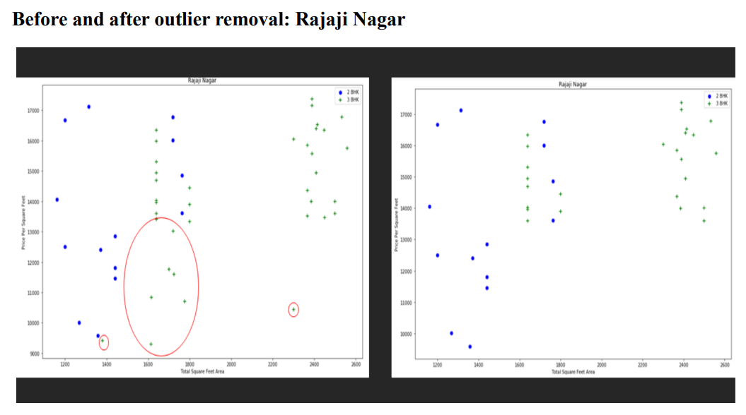
Important visualizations;

Slide 14
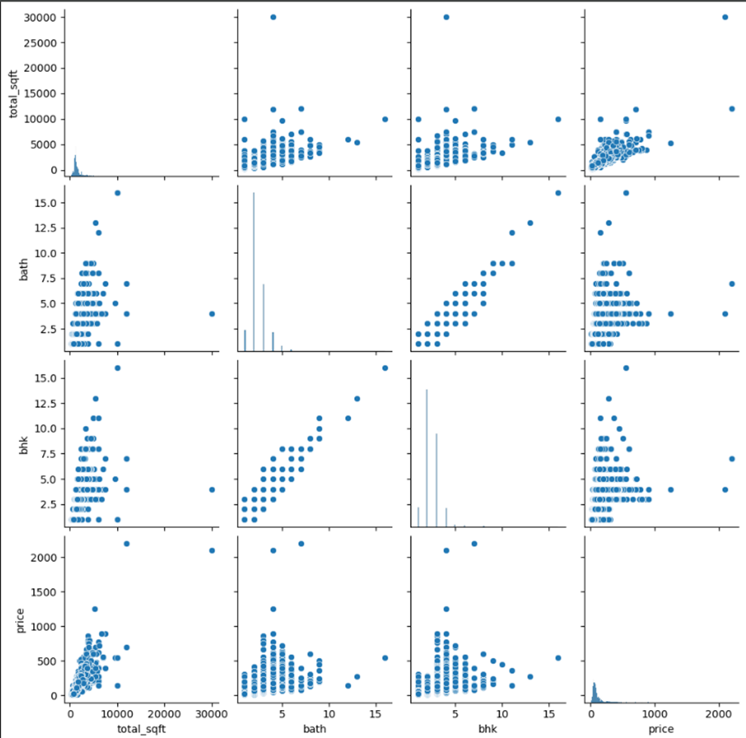
Scatter Plot

Slide 15
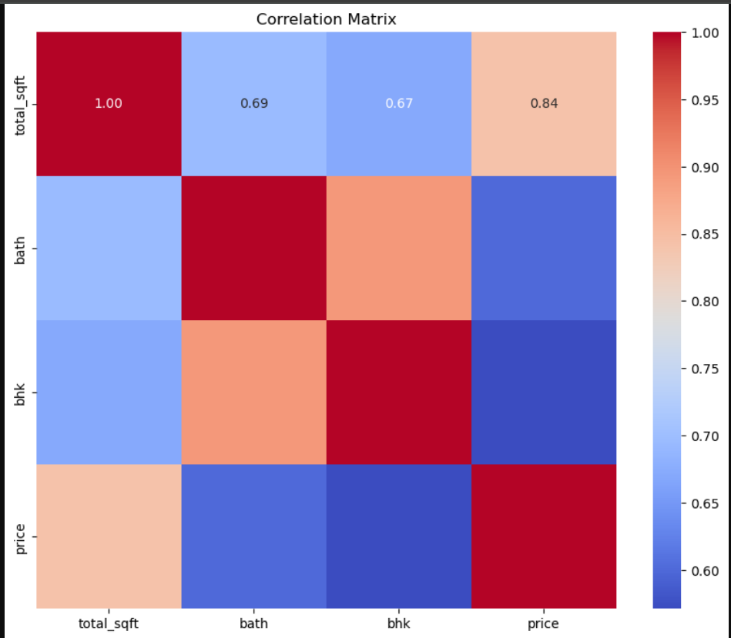
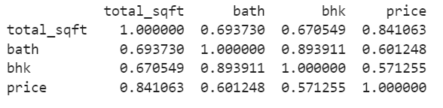

Slide 16
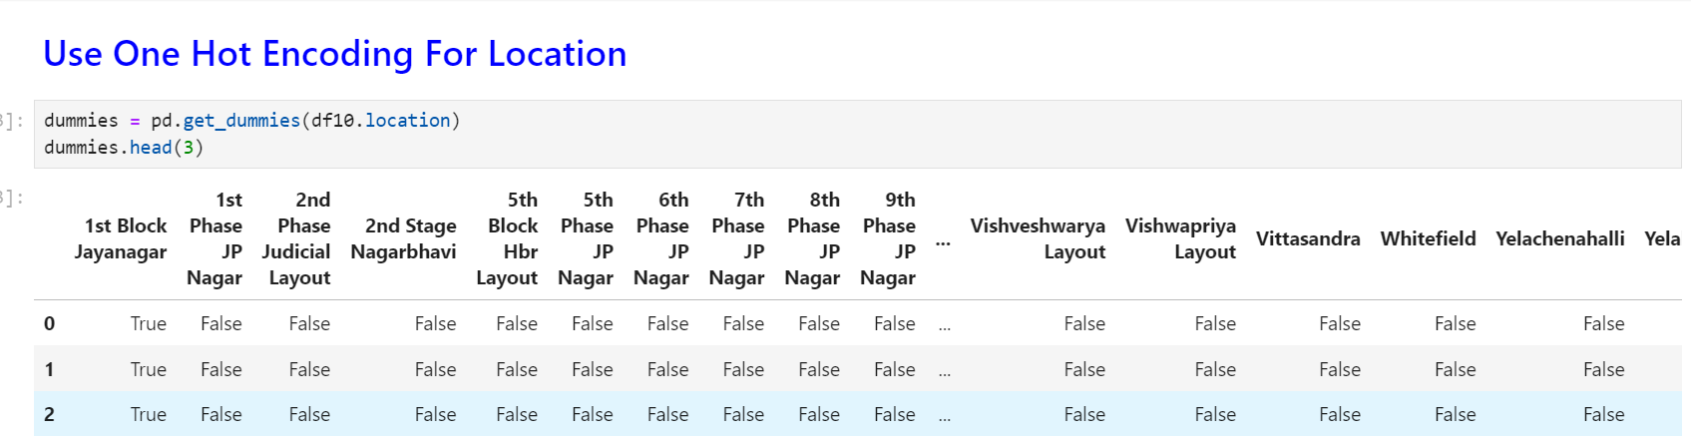
One hot encoding:
This technique is used to convert the categorical variables into numeric values.
Our dataset contain a categorical variable which is “location”.
We have used one hot encoding method to convert them as numeric values.
As we can see the location name 1st block Jayanagar having the value True and the rest of the location are treated as False.

Slide 17
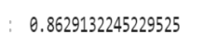
Model building;
The data was split into 80% for training and 20% for testing. This ensures that the model is trained on a sufficient amount of data while also allowing for an unbiased evaluation of its performance.
For our regression task, we chose to use a Linear Regression model, implemented through LinearRegression from sklearn.linear model on training dataset (x_train, y_train).
To assess the performance of our model, we used the testing dataset (x_test, y_test) and calculated the coefficient of determination (R-squared) using the score method.

Slide 18
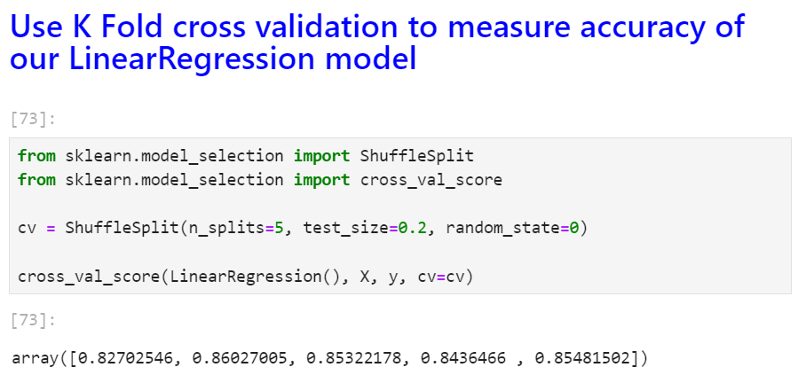
K-fold cross validation:
Cross – validation is statistical method used to estimate the skill of machine learning models.
It is commonly used in applied machine learning to compare and select a model for given predictive modelling problem because it is easy to understand, easy to implement, and results in skill estimate that generally have a lower bias than other methods.
After applying k-fold cross validation method into our final dataset, we find our accuracy rate is more than 80% all the time.

Slide 19
Grid search cross validation:
This is a technique which is used to find the best algorithm for modelling and give the best parameters as well.
We applied gird search cross validation method on our dataset with Linear Regression , Lasso Regression and Decision Tree algorithms.
We find the Liner Regression algorithm is giving the best accuracy score as more than 80%.

Slide 20
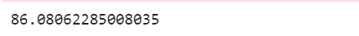
Result/ output:
We created a function to predict the house price.
Our function be like “ predict_price(loction, sqft,bath,bhk)”
When we pass the values into our function, it will predict house price for us.

Slide 21
Website:
We have successfully developed a Flask website that integrates our machine learning model for predicting house prices. This website provides users with a user-friendly interface to obtain price estimates based on various input parameters such as location, area, number of bathrooms, and number of bedrooms (BHK). Features.

Slide 22
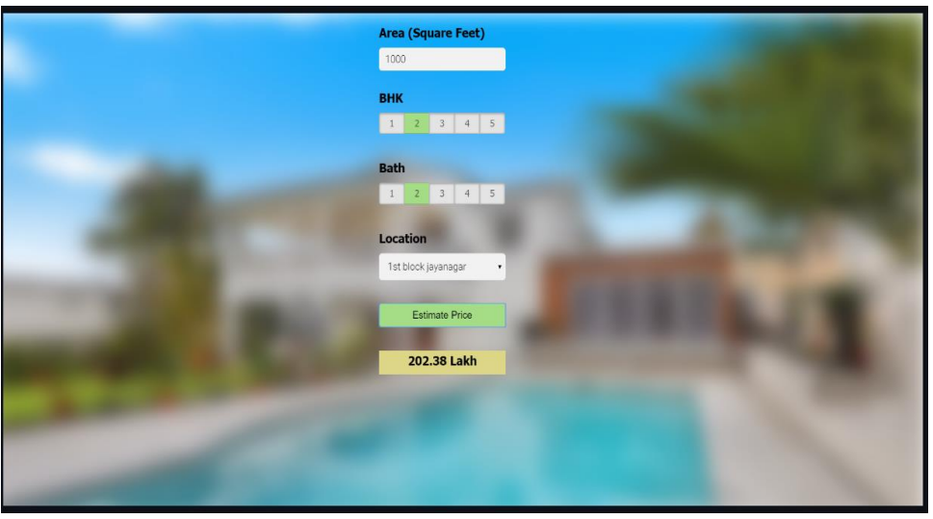

Slide 23
THANK YOU GROUP : STATISTICA

